Slide 1
SIMATIC Controller The intelligent choice for your automation task! Sales slides
siemens.com/controller
Unrestricted / © Siemens AG 2014. All Rights Reserved

Slide 2

Vision & Motivation General automation requirements
Globalization
Global service network for automation suppliers
Digitalization Remote access, remote maintenance
Easy handling
Easy installation, wiring and fast, efficient commissioning
Increased production output
High communication performance, fastest system response and efficient data processing
Protection of humans and machines
Integrated safety and security functions
Plant availability Fast error localization and elimination to reduce downtime
Demands of the automation market are user-friendly products, high performance and a scalable product portfolio

Slide 3
The SIMATIC Controllers Portfolio Always the right controller – plus integrated added value!
Engineered with TIA Portal
Advanced Controllers
Efficient engineering
SIMATIC S7-1500
Software Controllers
SIMATIC S7-1500
Innovative design
System performance
Reliable diagnostics
Distributed Controllers
SIMATIC ET 200 CPU
Safety Integrated
Basic Controllers
SIMATIC S7-1200
Security Integrated
Technology Integrated
Application complexity

Slide 4
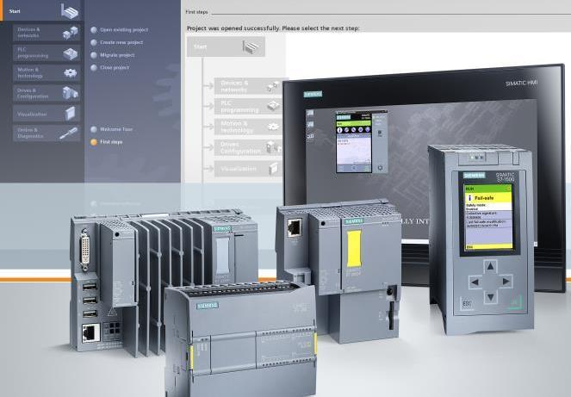
SIMATIC controller Scalable. Powerful. Easy to operate
+
Efficient engineering! One engineering system for all controllers: The TIA Portal!
Technology Integrated
Perfect integration of drives through motion control functionalities and PROFIdrive
+
Security Integrated and Safety Integrated
Secure your investment, Protect your know-how and for a safe machine operation!
+
Service made easy! Minimize downtime and increase your productivity
Scalable controller portfolio Complete portfolio with comprehensive functionalities and best performance in each category
+
+

Slide 5
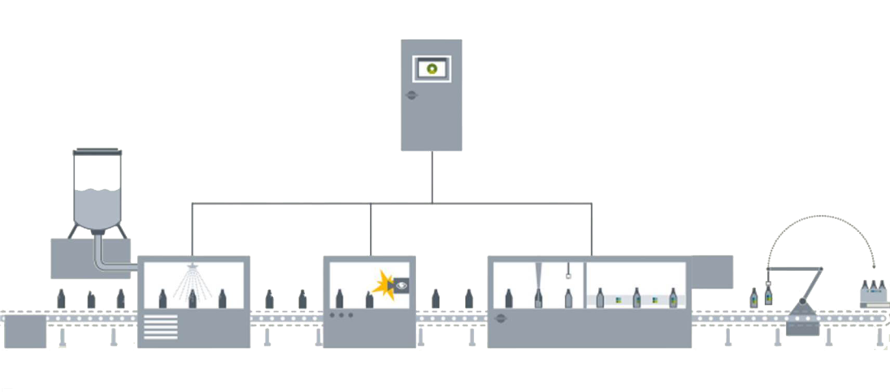




SIMATIC controller The intelligent choice for your automation task
Advanced Controller
SIMATIC S7-1500 Controller
Basic Controller
SIMATIC S7-1200 Controller
Distributed Controller SIMATIC ET 200SP CPU
SIMATIC S7-1500 Software Controller
Advanced Controller
SIMATIC S7-1500 Controller

Slide 6
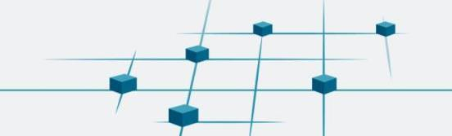


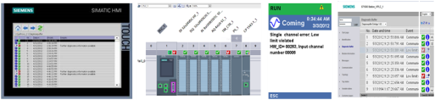
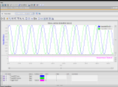
SIMATIC controller Innovative system functions for more productivity!
Part of Totally Integrated Automation … consistent engineering, diagnostics and communication
Completely integrated safety functions
… one controller and one engineering for standard and fail-safe automation
Uniform diagnostics without programming!
… efficient error analysis and consistent plain text information to reduce plant downtime

Slide 7




Scalable, consistent portfolio Complete portfolio with comprehensive functionalities
Advanced Controller
Unique power thanks to high performant backplane bus, shortest clamp-to-clamp reaction time and fastest signal processing
Highest level of user-friendliness
For highest productivity
Easy integration of the machine in the company network
Easy wiring as well as commissioning directly on the device!
Software Controller
PC-based controller for use on SIMATIC IPCs
Runs independently: Restart of Windows while controller in run.
Easy integration of PC applications and high-level languages – also for special tasks
Increased system availability and downtimes are avoided
Distributed Controller
Space-saving design while keeping familiar S7-1500 programming environment
Even PC-based with the ET 200SP Open Controller!
Space-saving distributed controller
Combines the benefits of S7-1500 with the layout of ET 200SP.
Basic Controller
Compact controller, failsafe also!
Modular expandable
Wide range of integrated technology functions.
Reduced need for additional special modules.
Saves space and money!

Slide 8
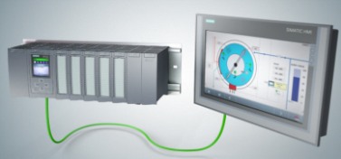

Security Integrated, Safety Integrated and Technology Integrated Innovative functions for more efficiency are already integrated
Feature / Function |  | Benefits
One controller for fail-safe and standard automation Functional safety certified to EN 61508 | ◆ | Reduced types and parts due to one automation system for standard and safety
Integrated motion control functions Integrated PID control with auto tuning | ◆ | Flexible connection of drives via PROFINET, PROFIBUS or analog interfaces Simple realization of loop control: continuous, discrete (pulse width modulation) or as step controller
Integrated know-how, copy and access protection Additional password protection for access to F-configuration and F-program | ◆ | High level of protection for intellectual property and investments as well as from unauthorized changes in the configuration

Slide 9
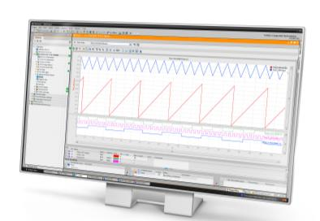


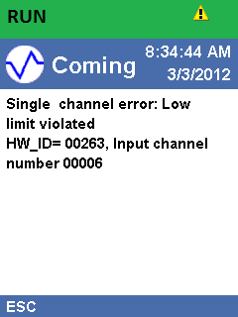

Service made easy! Minimize your downtime for higher productivity
Feature / Function |  | Benefits
Integrated trace log of variables with cycle-granular recording of process values for analysis | ◆ | Error localization even of sporadic errors
Integrated webserver Innovative memory card concept | ◆ | Diagnostics and service independent of engineering tool Simplifies updates or program transfer
Integrated system diagnostics with fine-granular messages in plain text | ◆ | No additional programming required Easy and fast error localization
User-friendly controllers thanks to easy wiring and smart replace concept for modules | ◆ | Easy installation prevents faults and saves time and money during (re)commissioning and in ongoing operation

Slide 10

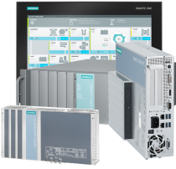

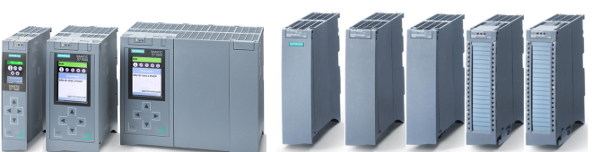
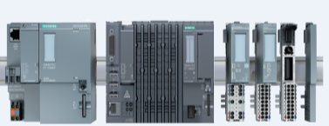
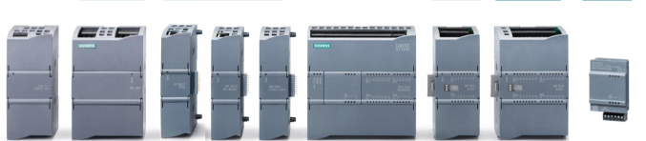
SIMATIC Controllers in the TIA Portal The intelligent choice for your automation task!
Advanced Controller (S7-1500)
Software Controller S7-1500
CPU
Interface modules
Power supply
Communication modules
Signal modules
Technology modules
Basic Controller (S7-1200)
Distributed Controller (ET 200SP CPU)
Switch modules
Power supply
Communication modules
CPU
Signal modules
Technology modules
Signal boards
CPU
ET 200SP modules
Notes:
CPUs -> CPUs, CPU modules, PLCs

Slide 11
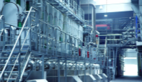
Dieffenbacher, wood industry Particle board production with TIA Portal and S7-1500
i
Challenges
Project information
!
Customer benefits
+
Realizing a new plant for a new particle board production for the company Pfleiderer.
1
Very short realization time of ½ year – incl. migration to new automation technology
Time savings for communication engineering Faultless configuration of connections with just a mouse click
TIA Portal realizes tasks in the background; Engineering via Drag & Drop
OEM Wood Industry
Eppingen / Germany
2
Reduced commissioning efforts
Integrated channel granular diagnosis, messages with time stamp
Products used
Fast fault identification saves 1 man-week
Error sources are quickly localized
Previous system |  | Now
S7-400 |  | S7-1500 CP
ET 200S |  | ET 200SP
WinCC V7 |  | WinCC Professional
Third party product |  | SINAMICS S120
Third party product |  | SITOP PSU100S
PROFIBUS |  | PROFINET
Trace: SPS Analyser |  | Integrierte Tracefunktion
3
Reduction of engineering effort for scalable machine portfolio
Reduced effort for new projects
Reuse of existing software from small machines to large plants
High scalability of complete S7-1500 family
Notes:
Value based Slide

Slide 12
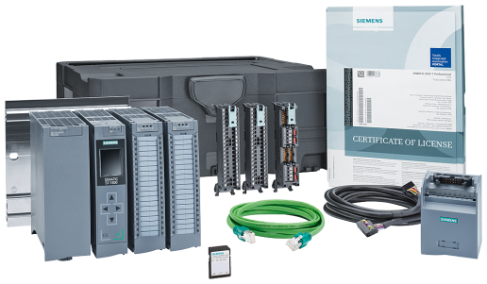
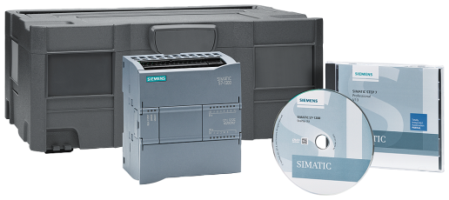
Why wait …when getting started is so easy?
Our starter kits are the perfect base for a fast and easy start!
Starter Kit S7-1500 :
6ES7511-1AK01-4YB5
Starter Kit S7-1200:
www.siemens.com/s7-1200-starterkits

